Slide 1
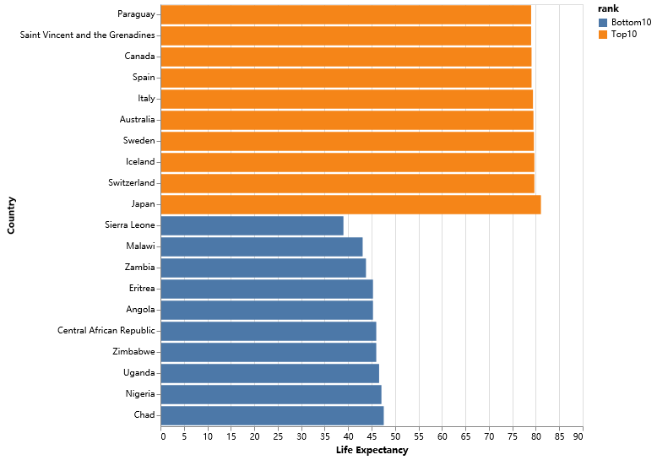
The huge gap in our world.
In 2000, Japan has a life expectancy larger than twice of Sierra Leone.
People in top10 countries averagely live 40 years longer than people in the bottom countries.

Slide 2
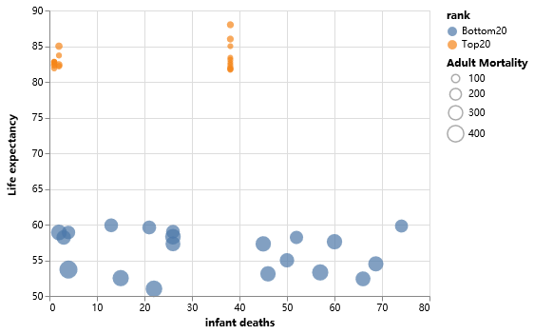
What result in the difference?
Despite some of the bottom countries have lower-than-average infant deaths, they also have significant higher adult mortality.

Slide 3
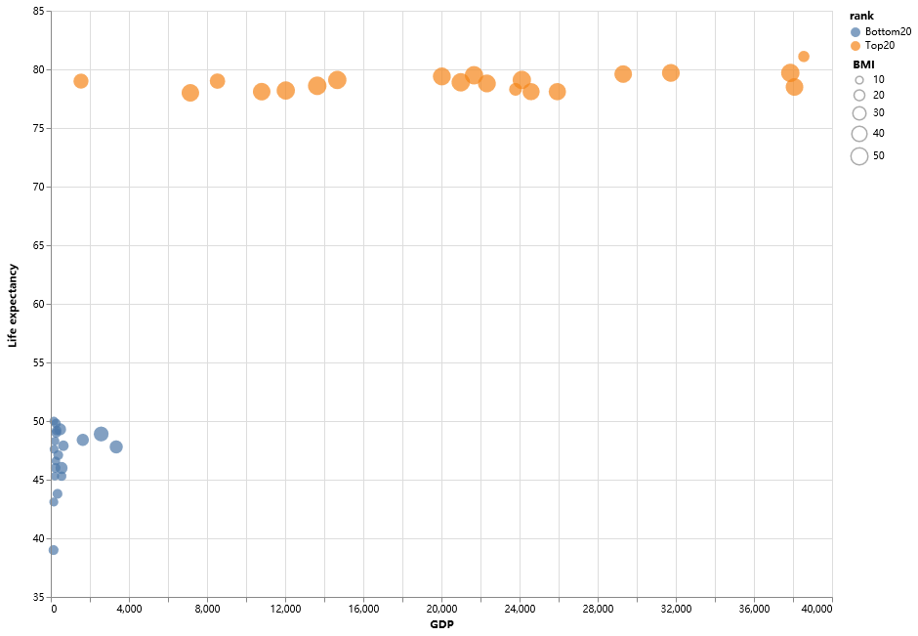
What result in the difference?
Higher BMI cause health problem?
In poor countries, people don’t even have enough food.

Slide 4
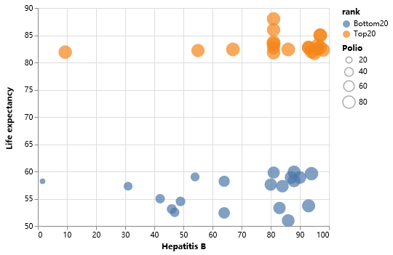
What result in the difference?
Despite having similar coverage of some vaccines, poor countries are still suffering.

